Slide 1

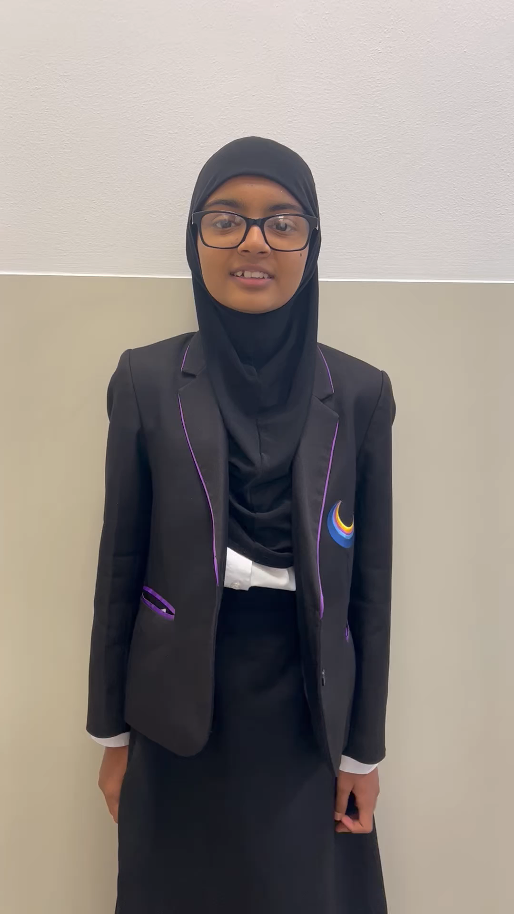
Click and
Listen to our pupil literacy lead
Pupil Literacy Lead

