Slide 1
Oracy matters
Preparing YOU for success

Slide 2
Today’s session is about...
what you should avoid in a ‘discussion’?
Why are you learning this?
Having effective discussion skills will help your personal growth. This is a LIFE SKILL.

Slide 3
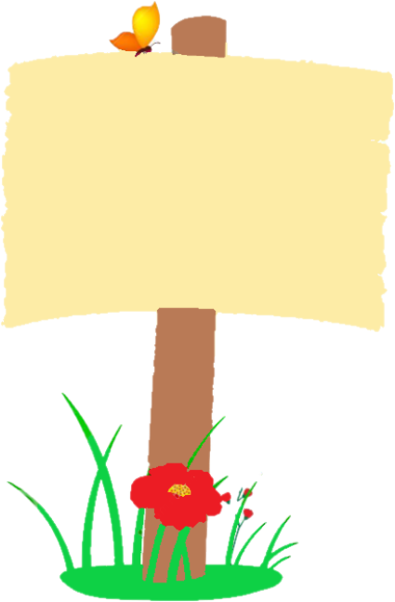






1
2
3
UNDERSTAND oracy and the power of talk
LEARN ABOUT formality and academic register language
LEARN ABOUT
non-verbal
communication
Time to… become an effective speaker and listener.
4
LEARN ABOUT
persuasive language
5
LEARN ABOUT
debates/discussion
6
ESTABLISH
‘Time to Talk’ rules
Preparing for
LEARN HOW TO
‘Time to Talk’ placemat
8
7
LEARN
how to choose the best arguments
‘Time to Talk’ Steps to Success
9
IDENTIFY
effective speaking strategies/ debate strategies
10
11
LEARN
how to plan for a debate.
SECURE UNDERSTANDING OF SKILLS

Slide 4

What does it mean?
DISCUSSION:
a conversation between two or more people about a specific topic

Slide 5
The Big Picture
In a few weeks, you will be required to create a set of rules to follow during group discussions. This session will help you to understand how you can set boundaries in a discussion so that you achieve your purpose.
Notes:
Resonance – the quality in the sound of being deep, full and reverberating.

Slide 6
What to do...
In the following recording , a group of 'pupils' are having a discussion. The topic that they are focussing on is online learning: is online learning better than in-person learning?
Notes:
Resonance – the quality in the sound of being deep, full and reverberating.

Slide 7
What to do...
Watch the video and write down what the pupils do badly in the discussion...
Notes:
Resonance – the quality in the sound of being deep, full and reverberating.

Slide 8
What to look for...
interruptions
informal language
shouting
off topic/social talk
lack of eye contact
not listening
no valid reasons for argument
no eye contact with the audience
not paying attention.
rude and aggressive behaviour
Challenge: can you find examples of the above?
Notes:
Resonance – the quality in the sound of being deep, full and reverberating.

Slide 9

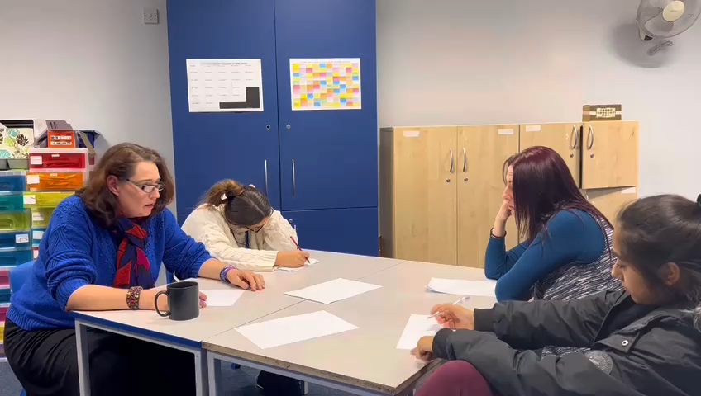
Notes:
Teacher notes: you may wish to provide the pupils with paper/post-it notes to jot down their ideas.

Slide 10
Oracy matters
What should you not do during an effective discussion?

