Slide 1
Oracy matters
Preparing YOU for success

Slide 2

What is today’s session about?
Today’s session will help you to revise what you learnt during

Slide 3
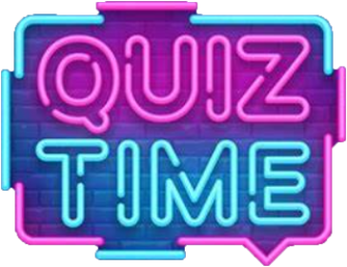

What is oracy?
Option 1
Option 2
Oracy is the ability to express oneself through written communication.
Oracy is the ability to understand different methods of travelling.
Option 3
Option 4
Oracy is the ability to understand how to succeed in the future.
Oracy is the ability to express oneself fluently and grammatically in speech
Notes:
Teacher notes: ask pupils to raise their hands for the option that they agree with.

Slide 4
Imagine you are studying English in a foreign country - which type of English would you be learning?
Standard English is the form of English that is taught around the world.
Option 2
Option 1
Standard English
Non-standard English.
Option 3
Option 4
slang
Colloquial language
Notes:
Teacher notes: ask pupils to raise their hands for the option that they agree with.

Slide 5
Which of these people would you speak to in non-standard English?
You would normally speak to your best friend and your parent or carer in non-standard English.
Option 1
Option 2
Your best friend
Your headteacher
Option 3
Option 4
dentist
Parent/carer
Notes:
Teacher notes: ask pupils to raise their hands for the option that they agree with.

Slide 6
Which of the following are common features of standard English?
Option 1
Option 2
formal words
Standard grammar
Option 3
Option 4
contractions
slang
Notes:
Teacher notes: ask pupils to raise their hands for the option that they agree with.

Slide 7
How would you say this sentence in polite, standard English?
"Alright, how's it goin'?"
Option 1
Option 2
"Hi there! What's up?"
"Hey, where are you going?"
Option 3
Option 4
“Hiya, what’s up?”
"Hello, how are you?"
Notes:
Teacher notes: ask pupils to raise their hands for the option that they agree with.

Slide 8
True or false: When you speak English using slang, everyone will understand you, no matter where you are.
Option 1
Option 2
False
True
Slang can be unique to certain locations or groups, so not everyone will understand it, even if they speak English.
Notes:
Teacher notes: ask pupils to raise their hands for the option that they agree with.

Slide 9
Which of the following are common features of standard English?
Option 1
Option 2
formal words
Standard grammar
Option 3
Option 4
contractions
slang
Notes:
Teacher notes: ask pupils to raise their hands for the option that they agree with.

Slide 10
How would you say this sentence in polite, standard English?
"Alright, how's it goin'?"
Option 1
Option 2
"Hi there! What's up?"
"Hey, where are you going?"
Option 3
Option 4
“Hiya, what’s up?”
"Hello, how are you?"
Notes:
Teacher notes: ask pupils to raise their hands for the option that they agree with.

Slide 11
True or false: When you speak English using slang, everyone will understand you, no matter where you are.
Option 1
Option 2
False
True
Slang can be unique to certain locations or groups, so not everyone will understand it, even if they speak English.
Notes:
Teacher notes: ask pupils to raise their hands for the option that they agree with.

Slide 12
Imagine you are studying English in a foreign country - which type of English would you be learning?
Standard English is the form of English that is taught around the world.
Option 2
Option 1
Standard English
Non-standard English.
Option 3
Option 4
slang
Colloquial language
Notes:
Teacher notes: ask pupils to raise their hands for the option that they agree with.

Slide 13
Which of these people would you speak to in non-standard English?
You would normally speak to your best friend and your parent or carer in non-standard English.
Option 1
Option 2
Your best friend
Your headteacher
Option 3
Option 4
dentist
Parent/carer
Notes:
Teacher notes: ask pupils to raise their hands for the option that they agree with.

Slide 14
Which of the following are common features of standard English?
Option 1
Option 2
formal words
Standard grammar
Option 3
Option 4
contractions
slang
Notes:
Teacher notes: ask pupils to raise their hands for the option that they agree with.

Slide 15
What is non-verbal communication?
Option 1
Option 2
To communicate without actual words
To communicate using the same words repetitively
Option 3
Option 4
To communicate with words.
To communicate using slang
Notes:
Teacher notes: ask pupils to raise their hands for the option that they agree with.

Slide 16
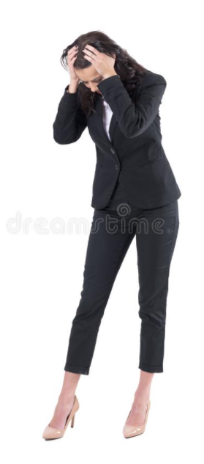
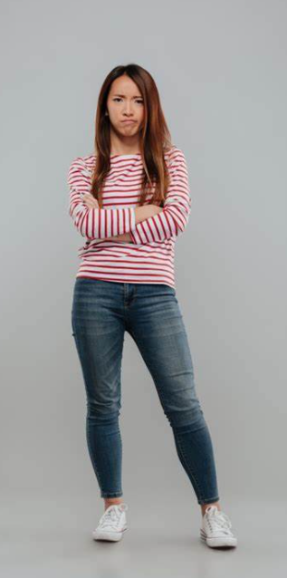
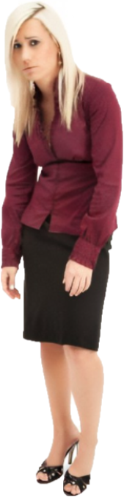
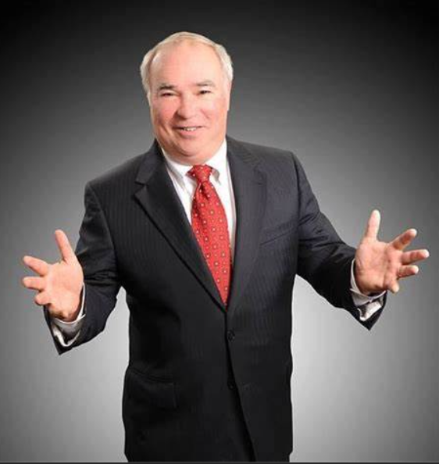
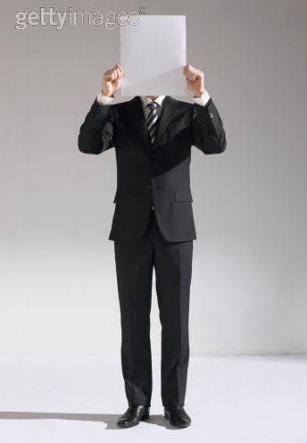
What does each stance tell you about the person?
Which is the best posture if you are delivering a presentation to a group of people?
Notes:
Teacher notes:
Inform pupils that their posture during an oral presentation should be standing up straight, relaxed and natural; their feet should be apart and shoulders squared, facing the audience. A relaxed, straight posture conveys confidence and authority to the audience.
Pupils shouldn’t slouch, look down, or fold their arms. Slouching suggests a lack confidence; looking down suggests nervousness; and, folding arms suggests hostility or defensive.

Slide 17
The best posture...
When you deliver oral presentations, you should be standing up straight, relaxed and natural; your feet should be apart and shoulders squared, facing the audience.
A relaxed, straight posture conveys confidence and authority to the audience.
You MUST NOT slouch, look down, or fold your arms. Slouching suggests a lack confidence; looking down suggests nervousness; and, folding arms suggests hostility or defensive.

Slide 18

What does this body language indicate?
Nail biting is a common body language behaviour that helps some people relieve tension and anxiety during stressful situations.
Option 1
confidence
Option 2
sadness
Option 3
nervousness
Option 4
shame
Notes:
Teacher notes: ask pupils to raise their hands for the option that they agree with.

Slide 19
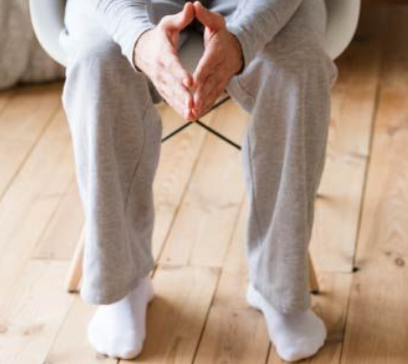
What does this body language indicate?
This hand gesture is called steepling. Steepling occurs when someone is typically feeling confident and in charge.
Option 1
confidence
Option 2
fear
Option 3
excitement
Option 4
happiness
Notes:
Teacher notes: ask pupils to raise their hands for the option that they agree with.

Slide 20

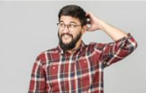
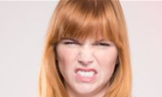

Which of the following pictures portrays the disgust?
Option 1
Option 3
Option 2
Option 4
Notes:
Teacher notes: ask pupils to raise their hands for the option that they agree with.

Slide 21
What does this body language indicate?
Nail biting is a common body language behaviour that helps some people relieve tension and anxiety during stressful situations.
Option 1
confidence
Option 2
sadness
Option 3
nervousness
Option 4
shame
Notes:
Teacher notes: ask pupils to raise their hands for the option that they agree with.

Slide 22
What does this body language indicate?
This hand gesture is called steepling. Steepling occurs when someone is typically feeling confident and in charge.
Option 1
confidence
Option 2
fear
Option 3
excitement
Option 4
happiness
Notes:
Teacher notes: ask pupils to raise their hands for the option that they agree with.

Slide 23
Which of the following pictures portrays the disgust?
Option 1
Option 3
Option 2
Option 4
Notes:
Teacher notes: ask pupils to raise their hands for the option that they agree with.

Slide 24
What does each stance tell you about the person?
Which is the best posture if you are delivering a presentation to a group of people?
Notes:
Teacher notes:
Inform pupils that their posture during an oral presentation should be standing up straight, relaxed and natural; their feet should be apart and shoulders squared, facing the audience. A relaxed, straight posture conveys confidence and authority to the audience.
Pupils shouldn’t slouch, look down, or fold their arms. Slouching suggests a lack confidence; looking down suggests nervousness; and, folding arms suggests hostility or defensive.

Slide 25
The best posture...
When you deliver oral presentations, you should be standing up straight, relaxed and natural; your feet should be apart and shoulders squared, facing the audience.
A relaxed, straight posture conveys confidence and authority to the audience.
You MUST NOT slouch, look down, or fold your arms. Slouching suggests a lack confidence; looking down suggests nervousness; and, folding arms suggests hostility or defensive.

