Slide 1
What is today’s session about?
To understand how to create examples of persuasive devices.

Slide 2
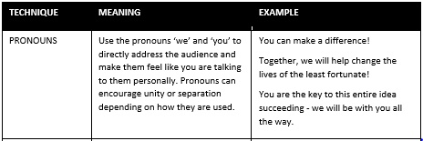
Persuasive techniques:
On the tables, there are different sheets with different persuasive techniques.
15 mins
They look like this.
Read the meaning and the examples; then create your own examples. Make sure you write your initials next to your example for an achievement point.

Slide 3
What will your examples be about?
Schools should finish at 6pm.
Do you agree/disagree?
Your examples should present your point of view.

Slide 4
Persuasive techniques:

Slide 5
Persuasive techniques:

Slide 6
Persuasive techniques:

Slide 7
Persuasive techniques:

Slide 8
Persuasive techniques:

Slide 9
Persuasive techniques:

Slide 10
Persuasive techniques:

Slide 11
Persuasive techniques:

Slide 12
Summer activity: let’s get persuasive!
TASK:
Your summer activity is to try and use the
different persuasive techniques in real-life situations.
Each time you use a skill in a real-life situation, record it on page 9 (of your oracy record booklet) and write the date. In September, if you can explain to your form tutor how you have utilised the skill with examples, you can achieve reward points.
Good luck!
Notes:
Teacher notes: please encourage pupils to take care of their booklets over the summer.

