Slide 1
Session 3:
Date: Wednesday, 13th July
FOCUS: non-verbal communication

Slide 2
Oracy matters
Preparing YOU for success

Slide 3
What is today’s session about?
1. What is non-verbal communication?

Slide 4

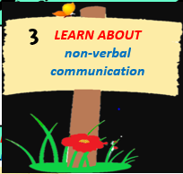




1
2
3
UNDERSTAND oracy and the power of talk
LEARN ABOUT formality and academic register language
LEARN ABOUT
non-verbal
communication
Time to… become an effective speaker and listener.
4
LEARN ABOUT
persuasive language
5
LEARN ABOUT
debates/discussion
6
ESTABLISH
‘Time to Talk’ rules
Preparing for
LEARN HOW TO
‘Time to Talk’ placemat
8
7
LEARN
how to choose the best arguments
‘Time to Talk’ Steps to Success
9
IDENTIFY
effective speaking strategies/ debate strategies
10
11
LEARN
how to plan for a debate.
SECURE UNDERSTANDING OF SKILLS
June 2022-December 2022

Slide 5

Three methods of communicating...
1. Verbal (words)
2. Non-verbal (no words)
3. Tone of voice
Task: which portion/percentage represents the three forms of communication? Label the pie chart with your answer.
7%
55%
Turn to page 5 of your oracy record booklet.
38%
Notes:
Teacher notes

Slide 6
Answer...
What the research shows...
Non-verbal communication is the most engaging form of communication. When we talk, we must think about what we are communicating non-verbally.
Verbal
7%
Tone of Voice
38%
55%
Non
Verbal

Slide 7
Non-Verbal Communication
What is non-verbal communication?
Non-verbal communication is how we make ourselves understood without speaking.
Non-verbal communication
Can you think of anything that you do to communicate other than talking?
Notes:
Teacher notes: ask the pupils to write their responses on the slide.

Slide 8
Non-verbal communication
Answers
Facial expressions
posture
Non-verbal communication
Head, hand and eye movements
gestures
Notes:
Teacher notes: reveal answers

Slide 9
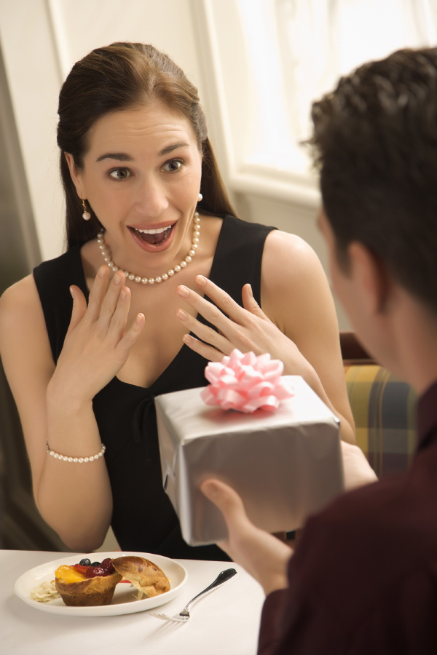
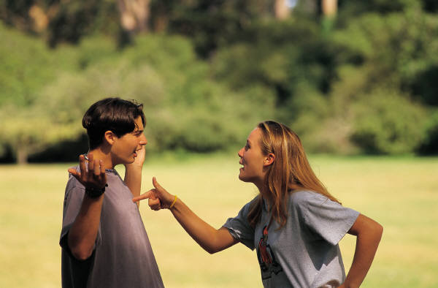
Body language
The best communicators use their body language to help to communicate their intended message.
Actions can sometimes speak louder than words! Your posture, facial expressions and gestures can help to present your feelings. Look at the two images.
What does the body language of each person reveal?
Notes:
We can create rapport by matching and mirroring another persons body language, voice and tonality. This creates a bridge between our world and theirs. This builds trust and is the basis of effective communication

Slide 10
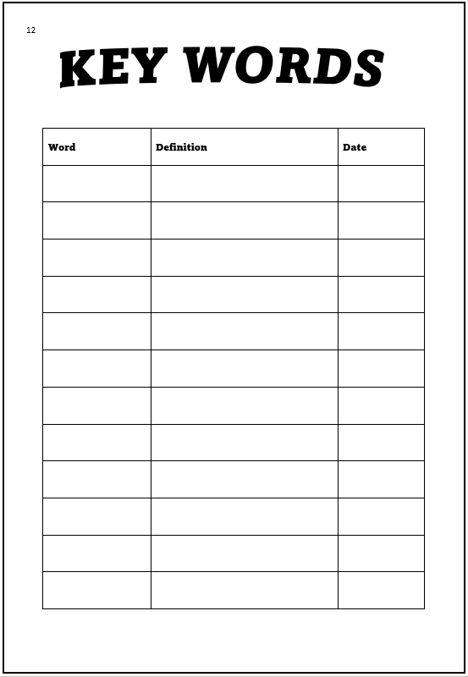
New word...
Add the word to page 12
rapport
a close relationship in which the people concerned understand each other's feelings or ideas and communicate well
Notes:
Teacher notes: add the notes to page 12

Slide 11
Non-Verbal Communication
What is non-verbal communication?
Non-verbal communication is how we make ourselves understood without speaking.
Non-verbal communication
Can you think of anything that you do to communicate other than talking?
Notes:
Teacher notes: ask the pupils to write their responses on the slide.

Slide 12
Non-verbal communication
Answers
Facial expressions
posture
Non-verbal communication
Head, hand and eye movements
gestures
Notes:
Teacher notes: reveal answers

Slide 13
Did you know?
We can create rapport by matching and mirroring another person’s body language and voice.
This builds trust and helps people to communicate effectively.

Slide 14
Non-Verbal Communication
What is non-verbal communication?
Non-verbal communication is how we make ourselves understood without speaking.
Non-verbal communication
Can you think of anything that you do to communicate other than talking?
Notes:
Teacher notes: ask the pupils to write their responses on the slide.

Slide 15
Non-verbal communication
Answers
Facial expressions
posture
Non-verbal communication
Head, hand and eye movements
gestures
Notes:
Teacher notes: reveal answers

Slide 16
Did you know?
We can create rapport by matching and mirroring another person’s body language and voice.
This builds trust and helps people to communicate effectively.

Slide 17



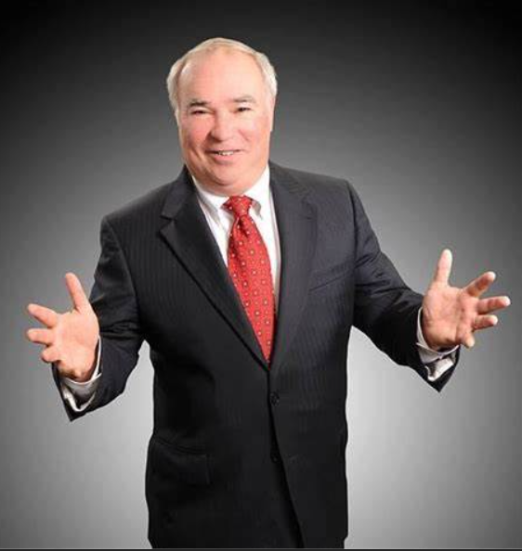

What does each stance tell you about the person?
Which is the best posture if you are delivering a presentation to a group of people?
Notes:
Teacher notes:
Inform pupils that their posture during an oral presentation should be standing up straight, relaxed and natural; their feet should be apart and shoulders squared, facing the audience. A relaxed, straight posture conveys confidence and authority to the audience.
Pupils shouldn’t slouch, look down, or fold their arms. Slouching suggests a lack confidence; looking down suggests nervousness; and, folding arms suggests hostility or defensive.

Slide 18
The best posture...
When you deliver oral presentations, you should be standing up straight, relaxed and natural; your feet should be apart and shoulders squared, facing the audience.
A relaxed, straight posture conveys confidence and authority to the audience.
You MUST NOT slouch, look down, or fold your arms. Slouching suggests a lack confidence; looking down suggests nervousness; and, folding arms suggests hostility or defensive.

Slide 19



What does this body language indicate?
Nail biting is a common body language behaviour that helps some people relieve tension and anxiety during stressful situations.
Option 1
confidence
Option 2
sadness
Option 3
nervousness
Option 4
shame
Notes:
Teacher notes: ask pupils to raise their hands for the option that they agree with.

Slide 20

What does this body language indicate?
This hand gesture is called steepling. Steepling occurs when someone is typically feeling confident and in charge.
Option 1
confidence
Option 2
fear
Option 3
excitement
Option 4
happiness
Notes:
Teacher notes: ask pupils to raise their hands for the option that they agree with.

Slide 21




Which of the following pictures portrays the disgust?
Option 1
Option 3
Option 2
Option 4
Notes:
Teacher notes: ask pupils to raise their hands for the option that they agree with.

Slide 22
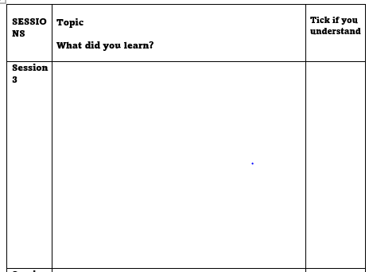
TASK:
Turn to page 6 of your ‘Pupil Oracy Record’ booklet.
Complete the section for session 3.
What did you learn about non-verbal communication?
Notes:
Teacher notes: ask pupils to write everything they have learnt in the session that will help them with their talk in lessons.
Review learning to support them
What is formality?
What is the difference between standard and non-standard English?
What is ‘academic register’?

Slide 23
1
2
3
UNDERSTAND oracy and the power of talk
LEARN ABOUT formality and academic register language
LEARN ABOUT
non-verbal
communication
Time to… become an effective speaker and listener.
4
LEARN ABOUT
persuasive language
5
LEARN ABOUT
debates/discussion
6
ESTABLISH
‘Time to Talk’ rules
Preparing for
LEARN HOW TO
‘Time to Talk’ placemat
8
7
LEARN
how to choose the best arguments
‘Time to Talk’ Steps to Success
9
IDENTIFY
effective speaking strategies/ debate strategies
10
11
LEARN
how to plan for a debate.
SECURE UNDERSTANDING OF SKILLS
June 2022-December 2022
Notes:
Teacher notes: direct the pupils to tick off step 3.

Slide 24
Summer activity: let’s get persuasive!
Turn to page 10/11 of your ‘Pupil Oracy Record’ booklet.
These pages will help you to learn a range of persuasive techniques. You will have an opportunity to practise using these techniques in your English lesson.
Effective speakers can use persuasive techniques to convince and build rapport with their listeners.

Slide 25
Summer activity: let’s get persuasive!
TASK:
Your summer activity is to try and use the
different persuasive techniques in real-life situations.
Each time you use a skill in a real-life situation, record it on page 9 and write the date. In September, if you can explain to your form tutor how you have utilised the skill with examples, you can achieve reward points.
Good luck!
Notes:
Teacher notes: please encourage pupils to take care of their booklets over the summer.

