Slide 1
Session 2, part 1:
Date: Wednesday, 29th June
FOCUS: FORMALITY

Slide 2
Oracy matters
Preparing YOU for success

Slide 3






1
2
3
UNDERSTAND oracy and the power of talk
LEARN ABOUT formality and academic register language
LEARN ABOUT
non-verbal
communication
Time to… become an effective speaker and listener.
4
LEARN ABOUT
persuasive language
5
LEARN ABOUT
debates/discussion
6
ESTABLISH
‘Time to Talk’ rules
Preparing for
LEARN HOW TO
‘Time to Talk’ placemat
8
7
LEARN
how to choose the best arguments
‘Time to Talk’ Steps to Success
9
IDENTIFY
effective speaking strategies/ debate strategies
10
11
LEARN
how to plan for a debate.
SECURE UNDERSTANDING OF SKILLS
June 2022-December 2022
Notes:
Teacher notes: tell the pupils that they will be focussing on step 2 today. Ask the pupils to place a tick in their booklet when completed at the end of the lesson.

Slide 4
What is today’s session about?
What is formality?
What is the difference between standard and non-standard English?
Notes:
Teacher notes: tell pupils that they will should be able to answer these questions at the end of the session.

Slide 5
What is formality?
Formality of spoken language relates to making the decision to either speak using a formal version or an informal version of language.
Watch the clip on the next slide which highlights the difference between two versions of the English language – standard English and non-standard English.
Pay attention - you will be asked to write the meaning using your own words.

Slide 6




TASK:
Answer the questions:
What is standard English?
What is non-standard English ?
Notes:
Teacher notes: you may wish to provide the pupils with paper/post-it notes to jot down their ideas.

Slide 7
What is standard English?
Standard English is a variety of English that is clear and most easily understood by a wide audience. It follows grammatical rules and uses the correct tenses. This version is the norm for formal settings or where the audience is large or unknown.
If everyone speaks in a standardised variety of English, we are more likely to understand each other.
Turn to page 12 of your ‘Pupil Oracy Record’ booklet and write the definition in your own words.
Notes:
Teacher notes;
Inform the pupils that standard English is not the only or ‘correct’ form of English. There are regional dialect words and generational differences. Standard English is the norm and the most valued form version in education.

Slide 8
What is non-standard English?
Colloquial language is the way you all speak when in informal situations, with your friends or family. It includes words and phrases that are particular to your age group and the area where you live as well. This means colloquial language can include dialect words and slang.
These non-standard English words and forms are easily understood by certain groups of people, but might be unfamiliar to other groups.
Turn to page 12 of your ‘Pupil Oracy Record’ booklet and write the definition in your own words.
Notes:
Teacher notes;
Inform the pupils that standard English is not the only or ‘correct’ form of English. There are regional dialect words and generational differences. Standard English is the norm

Slide 9
We need to learn to switch between formal and informal language …
When we speak or write, we need to consider our audience and identify whether it is a formal situation or an informal situation and whether we should use standard English or non-standard English.
Notes:
Teacher notes:
Inform pupils that their language is a part of their identity and they should value their version of language that they use. However, they must learn to switch to standard English when the situation requires it.

Slide 10
TASK INSTRUCTIONS
On the next slide, there is a table. In the middle column there is a list of people that you could talk to/write to.
Decide whether each example is a formal situation or an informal situation.
Show your response by raising your hand for your chosen option.
Notes:
Teacher notes: as pupils to raise their hands identifying formal or informal situations.

Slide 11

Let’s try this…
Ask yourself: do you know the person, or are they in a position of authority?
Formal |  | Informal | Informal
 | Chatting with friends about a film
 | Asking your teacher a question
 | Writing to your local member of parliament (MP)
 | Greeting the queen
Chatting with friends about a film
These are all formal situations, therefore require you to use standard English.
Asking your teacher a question
Read the situation, and decide whether it is formal or informal.
Writing to your local member of parliament (MP)
Greeting the queen
Notes:
Teacher notes:
In the middle column there is a list of people and places that you could talk to or write to. Ask the pupils to decide whether it is a formal situation or an informal situation. Ask them to show their response with a show of hands. Go through each example and ask pupils to show their hands if they think it is formal/informal and then reveal the answer.
Tell the pupils, when it’s a formal situation, they must use standard English.

Slide 12
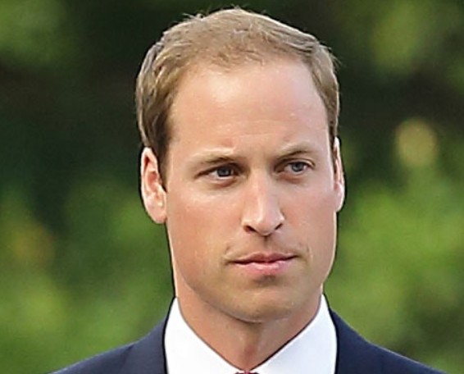



Prince William is coming to dinner…
The question is whether he would like…
….with his chicken curry.
rice
naan
or
Ask your partner: how would you ask Prince William what he wants to eat?
Share your response.
Notes:
Teacher notes: review their learning. Ask pupils to read the slide. Prince William is coming for dinner – how would they ask him what he wants to eat?
Tell them to tell the person next to them.

Slide 13
Did you ask the question using standard English?
Prince William, would you prefer rice or naan with your meal?
The Prince may be a familiar face, and we may be in our own home, however, most of us don’t know him personally so we should use formal language and standard English.
Standard English
Notes:
Teacher notes:
The Prince may be a familiar face, and we may be in our own home, however, most of us don’t know him personally so we should use formal language and standard English.

Slide 14
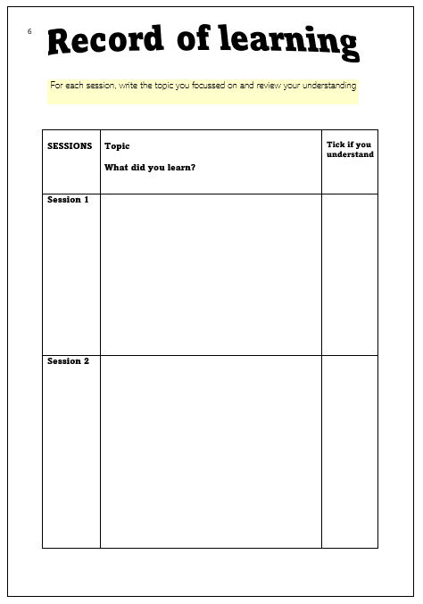
TASK:
Turn to page 6 of your ‘Pupil Oracy Record’ booklet.
Complete the section for session 2.
What did you learn about formality?
Notes:
Teacher notes: ask pupils to write everything they have learnt in the session that will help them with their talk in lessons.
Review learning to support them
What is formality?
What is the difference between standard and non-standard English?
What is ‘academic register’?

Slide 15
Session 2, part 2:
Date: Wednesday, 6 July
FOCUS: ACADEMIC EXPRESSION

Slide 16
What is today’s session about?
What is ‘academic register’?
Why do we need to learn to use standard English?
Notes:
Teacher notes: tell pupils that they will should be able to answer these questions at the end of the session.

Slide 17
1
2
3
UNDERSTAND oracy and the power of talk
LEARN ABOUT formality and academic register language
LEARN ABOUT
non-verbal
communication
Time to… become an effective speaker and listener.
4
LEARN ABOUT
persuasive language
5
LEARN ABOUT
debates/discussion
6
ESTABLISH
‘Time to Talk’ rules
Preparing for
LEARN HOW TO
‘Time to Talk’ placemat
8
7
LEARN
how to choose the best arguments
‘Time to Talk’ Steps to Success
9
IDENTIFY
effective speaking strategies/ debate strategies
10
11
LEARN
how to plan for a debate.
SECURE UNDERSTANDING OF SKILLS
June 2022-December 2022
Notes:
Teacher notes: tell the pupils that they will be focussing on step 2 today. Ask the pupils to place a tick in their booklet when completed at the end of the lesson.

