Slide 1
Oracy matters
Preparing YOU for success

Slide 2
Session 1:
Date: Wednesday, 6th September 2022
FOCUS: INTRODUCTION TO #TIME TO TALK

Slide 3
What is today’s session about?
What is oracy and why is it important?
Notes:
Teacher notes: tell pupils that they will be answering these questions during the session.

Slide 4




TASK:
Watch the video and answer the questions:
What is oracy?
Why is it important?
Notes:
What is oracy?
Oracy is the ability to express oneself fluently, accurately and eloquently in speech.
Why is it important?

Slide 5
Feedback
Oracy is the ability to express oneself fluently, accurately and eloquently in speech.
Notes:
Ask pupils for the definition of oracy in their own words:
Oracy: the ability to express oneself fluently, accurately and eloquently in speech

Slide 6

The power of oracy
Every Wednesday (Week A) during form period, you will be learning how to become effective communicators.
These sessions will be called
These opportunities will help you achieve success, not only in school, but in life after school.

Slide 7

Put your hand up if …
…you’ve ever felt too embarrassed to share an answer in class?
…you’ve ever wanted to talk in front of your peers, but you were too scared?
…you’ve ever wondered how people sound confident when they talk?

Slide 8
Put your hand up if …
…not being able to talk in front of people has stopped you from sharing your opinion about something important?
…not being able to talk has prevented you from achieving something?
YOU ARE NOT ALONE!
will help you become a better communicator!

Slide 9
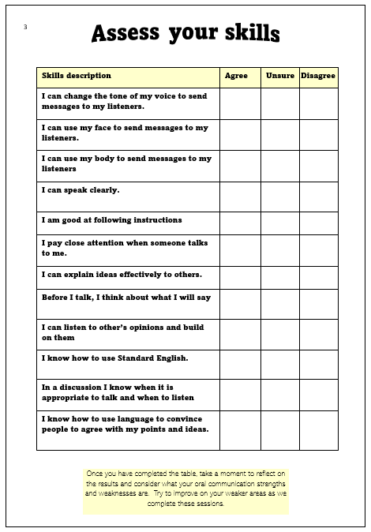
What to do?
Turn to page 3 of your ‘Pupil Oracy Record’ booklet.
Please complete the skills audit – read each statement and tick the column which applies to you.
Notes:
Teacher notes: inform the pupils that they may not understand some of these statements, but they shouldn’t be worried – the purpose is to learn how to communicate using the techniques and strategies so after the different sessions, the pupils will have a better understanding.

Slide 10

Assess your oracy skills
Skills description | Agree | Unsure | Disagree
I can change the tone of my voice to send messages to my listeners.
I can use my face to send messages to my listeners.
I can use my body to send messages to my listeners
I can speak clearly.
I am good at following instructions
I pay close attention when someone talks to me.
I can explain ideas effectively to others.
Before I talk, I think about what I will say
I can listen to other’s opinions and build on them
I know how to use Standard English.
In a discussion I know when it is appropriate to talk and when to listen
I know how to use language to convince people to agree with my points and ideas.
It is important for you to be able to evaluate your skills because it gives you an indication of your starting point and allows you to think about where you can improve. At the end of your learning, it will allow you to monitor your performance.

Slide 11
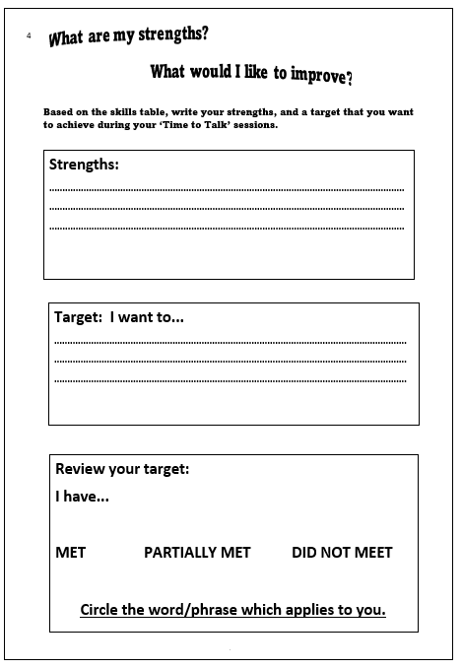
What to do?
Turn to page 4 of your ‘Pupil Oracy Record’ booklet.
Based on the skills audit, write your strengths, and a target that you want to achieve during your ‘Time to Talk’ sessions.
WE WILL BE REVIEWING THIS TARGET BEFORE THE END OF THE ACADEMIC YEAR.
Notes:
Teacher notes: explain to the pupils that they will be reviewing whether they have achieved the target before the end of the term.

Slide 12
What is oracy?
What have you learnt?
Option 1
Option 2
Oracy is the ability to express oneself through written communication.
Oracy is the ability to understand different methods of travelling.
Option 3
Option 4
Oracy is the ability to understand how to succeed in the future.
Oracy is the ability to express oneself fluently and grammatically in speech
Notes:
Teacher notes: ask pupils to raise their hands for the option that they agree with.

Slide 13
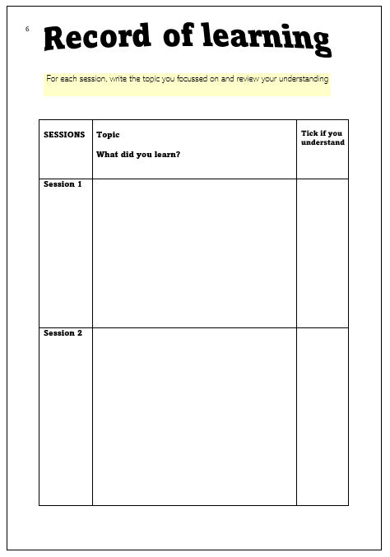
TASK:
Turn to page 6 of your ‘Pupil Oracy Record’ booklet.
Complete the section for session 1.

Slide 14


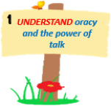


1
2
3
UNDERSTAND oracy and the power of talk
LEARN ABOUT formality and academic register language
LEARN ABOUT
non-verbal
communication
Time to… become an effective speaker and listener.
4
LEARN ABOUT
persuasive language
5
LEARN ABOUT
debates/discussion
6
ESTABLISH
‘Time to Talk’ rules
Preparing for
LEARN HOW TO
‘Time to Talk’ placemat
8
7
LEARN
how to choose the best arguments
‘Time to Talk’ Steps to Success
9
IDENTIFY
effective speaking strategies/ debate strategies
10
11
LEARN
how to plan for a debate.
SECURE UNDERSTANDING OF SKILLS
June 2022-December 2022
Notes:
Teacher notes: pupils must tick to show that they have completed the session.

